Slide 1
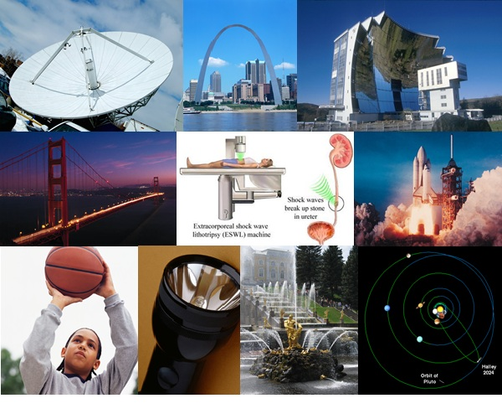
MATHEMATICS –
CONIC SECTIONS
BY-
ANANYA SEN
11-A

Slide 2
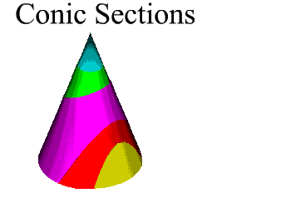
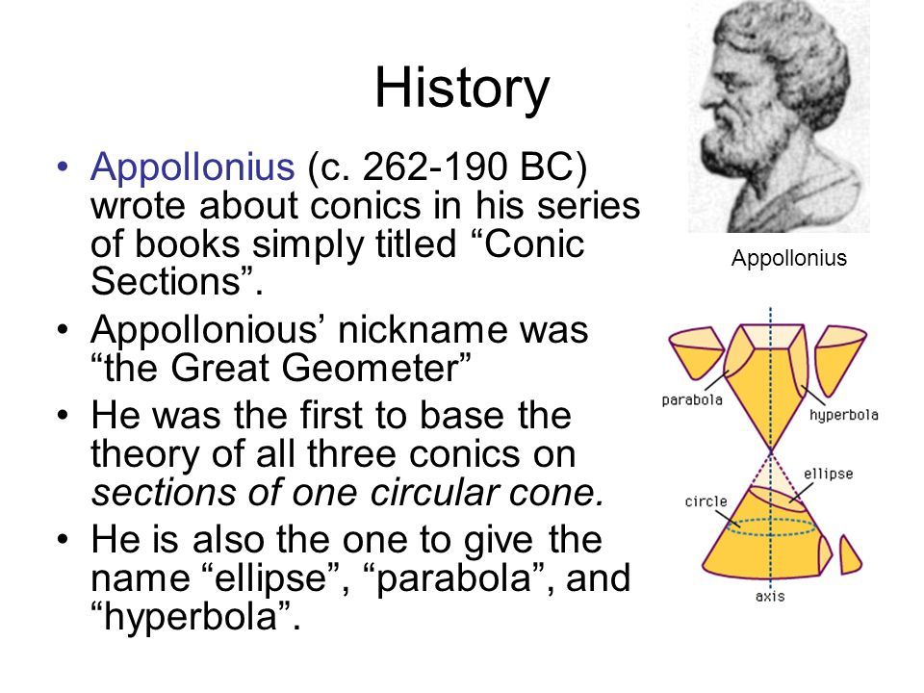
A conic section is the intersection of a plane and a cone.

Slide 3
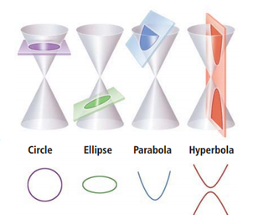
By changing the angle and location of intersection, we can produce a circle, ellipse, parabola or hyperbola.

Slide 4
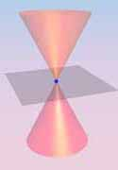
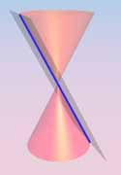
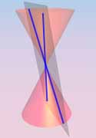
in the special case when the plane touches the vertex: a point, line or 2 intersecting lines.

Slide 5

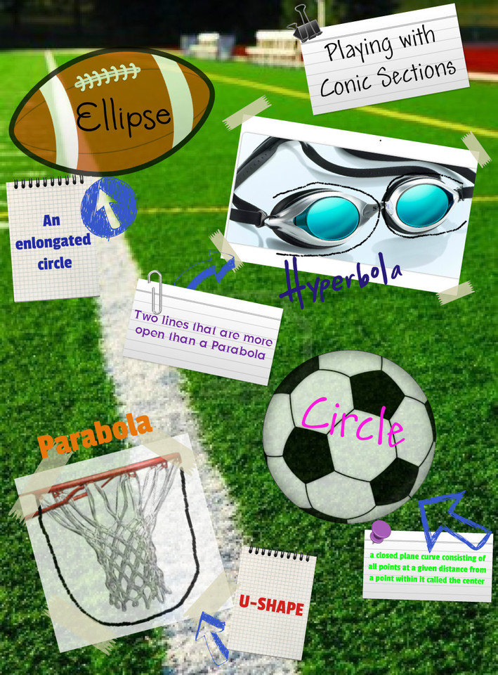
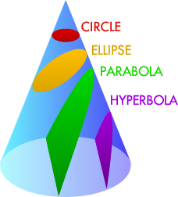

Slide 6
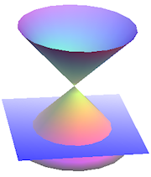
CIRCLE
.
A circle is the set of all points in a plane that are equidistant
from a fixed point in a plane.
*The circle is a special case of the ellipse

Slide 7
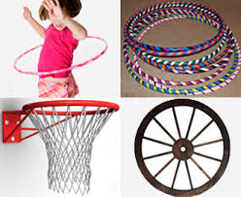
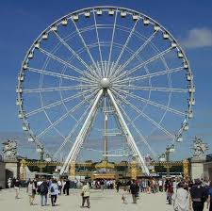
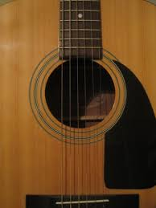
Circles in our surrounding-

Slide 8
EQUATIONS OF CIRCLE
The equation of a circle with center at (a,b) and radius r units is
(x−a)²+(y−b)² = r²
If centre is (0,0) and radius is r, then equation of circle is
x² + y² = r²
If equation of circle is x^2+y^2+2ax+2by+c=0, then
centre=(-a,-b)
radius=√(a²+b²-c)

Slide 9
EXAMpLES-
Q. Find the equation of the circle with-Centre(-2,3) and radius 4
A. a= -2, b= 3 and r= 4
Since, the equation of motion is(x−a)^2+(y−b)^2=r^2
So, on putting the values we get,
(x+2)^2+(y-3)^2=r^2
Q. Find the centre and radius of the circle: (x^2+y^2-4x-8y-45=0)
A. On comparing the given eq. with x^2+y^2+2ax+2by+c=0
Where, centre=(-a,-b) and radius=√(a^2+b^2-c)
2a= - 4→a= - 2, 2b= - 8 →b= - 4, c= -45
Centre = (2,4) and radius= √(4+16+45)= √65
Q. Find the equation of the circle whose centre lies on the line 4x+y=16 and which passes through the points(4,1) and (6,5).
Let the eq. of the circle be, x^2+y^2+2gx+2fy+c=0 the circle passing through the points (4,1) and (6,5)
16+1+8g+2f+c=0 → 8g+2f+c= -17 ---(1)and 36+25+12g+10f+c=0 →12g+10f+c= -17----(2)
On subtracting we get, g+2f= -11 ----------------(3)
Since the centre (-g,-f) lie on the line 4x+y=16 ----------------(4)
On subtracting eq. (3) and (4) we get, g= -3
On putting the value of g in eq. (3) we get, f = -4
Putting values of g and f in eq.(1) we get c=15
Therefore eq. of circle + x^2+y^2-6x-8y+15=0

Slide 10
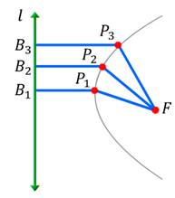
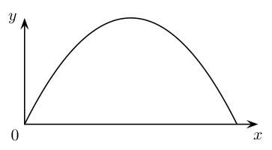

PARABOLA
A parabola is the set of all points in a plane that are equidistant from a fixed line and a fixed point in the plane.

Slide 11
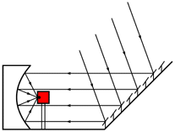
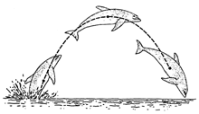
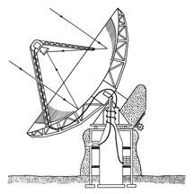
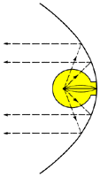
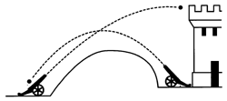
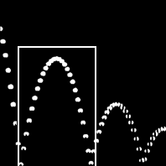
Parabola in our surrounding-

Slide 12
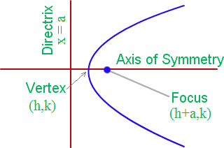
Terms related to a parabola
Axis
The straight line passing through the focus and perpendicular to the directrix is called the axis of the parabola.
Focus:
The focus of a parabola is a fixed point in the interior of the parabola.
Focal distance:
The distance of a point on the parabola from its focus
is called the focal distance of the point.

Slide 13
Vertex:
The vertex of a parabola is the point where the parabola crosses its axis. When the coefficient of the x² term is positive, then the vertex is the lowest point on the graph but in case it is negative the vertex will be the highest point on the graph.
Directrix:
A line perpendicular to the axis of symmetry is called the directrix.
Latus Rectum:
The latus rectum of a conic section is the chord through a focus parallel to the conic section directrix. The quantity 4a is known as the latus rectum. Half the latus rectum is called the semilatus rectum.

Slide 14
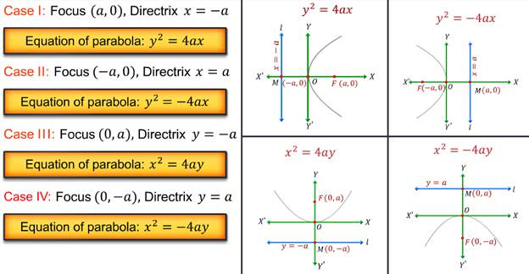
Equations of parabola

Slide 15
EXAMPLES-
Q. Find the coordinates of the focus and the vertex, the eq. of the diretrix and the axis, and length of the latus rectum of the parabola y^2=8x.
A. Comparing with y^2= -4ax, a=2
Focus=(-a,0)=(-2,0)
Axis=x axis
Eq. of Directrix, x-a=o so, x-2=0
Latus rectum=4a=8
Q. Find the coordinates of the focus and the vertex, the eq. of the diretrix and the axis, and length of the latus rectum of the parabola
X^2= -16y
A.On comparing with x^2= -4ay, a=4
Focus=(0,-a)=(0,-4)
Axis=y axis
Eq. of Directrix, y=a so, y=4
Latus rectum=4a=16
Q. Find the eq. of the parabola with vertex at the origin, passing through the point P(3,-4) and symmetric about the y-axis.
Let its eq. be x^2= -4ay
X=3 and y= -4
So, a=9/16
So, the required eq. is , x^2= (-9/4)y→ 4x^2+9y=0

Slide 16
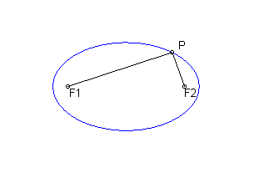
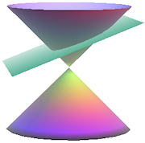
Fig…
ELLIPSE
It is a path traced by a point which moves in a plane in such a way that the sum of its distance from two points in the plane is constant.

Slide 17
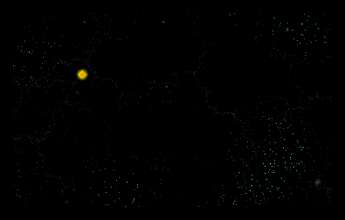

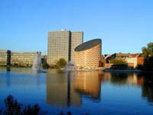
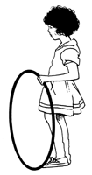
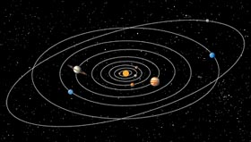
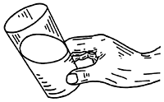
Ellipse in our surrounding-

Slide 18
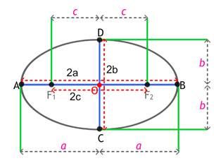
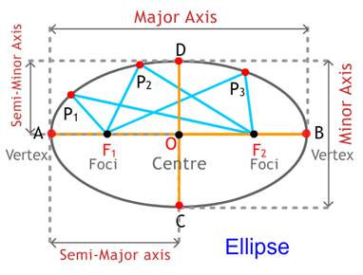
Terms related to ellipse -
The fixed points in the plane are the two focus points of an ellipse, jointly called the foci.
The line segment passing through the foci of an ellipse and touching it is called the major axis of the ellipse
The two points where the major axis touches the ellipse are called the vertices of the ellipse.
The mid-point of the major axis, or the midpoint of the line segment joining the foci of an ellipse, is called the centre of the ellipse.
ELLIPSE…

Slide 19
The line segment passing through the centre of an ellipse and perpendicular to the major axis is called the minor axis of the ellipse.
Semi-major axis = ½ major axis = a
Semi-minor axis = ½ minor axis = b
Eccentricity of an ellipse is the ratio of the distances from the centre of the ellipse to onr=e of the foci and to one of the vertices of the ellipse. E=c/a, b^2=a^2(1-e^2). e<1

Slide 20
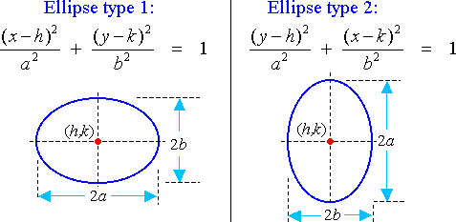
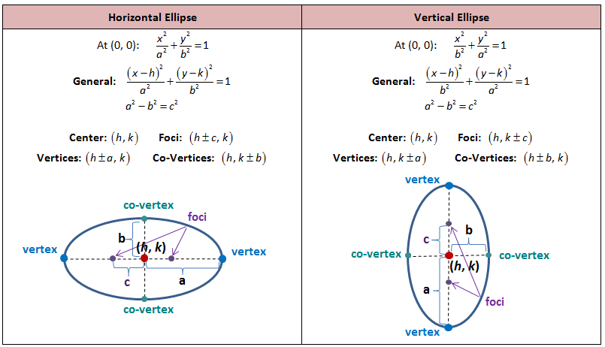
Equations of ellipse
(0,0)
(0,0)
Focus- (±ae,0)
Vertices-(±a,0)
Directrix- x = ±(a/e)
Latus rectum= 2b^2/a
Distances between the foci= 2ae
Distance between directrices- 2a/e
Focus- (0,±ae)
Vertices-(0,±a)
Directrix- x = ±(a/e)
Latus rectum= 2b^2/a
Distances between the foci= 2ae
Distance between directrices- 2a/e

Slide 21
Examples-
Q. Find the lenghts of the major axes; coordinates of the vertices and the foci, the eccentricity and the length of the latus rectum of the ellipse x^2/4+y^2/25=1
A. Comparing with x^2/b^2+y^2/a^2=1
a^2=4, a=2 and b^2=25, b=5
b^2=a^2(1-e^2), e= √ 21/5
Therefore, foci= (0,± ae) ,(±√ 21 )
Vertices= (0,± a) ,=(0,±5) and (0, ±2)
Major axis=2a ,10
Minor axis=2b ,4
Latus rectum= 2^2/a=8/5
Q. Find the equation of the ellipse, the ends of whose major axis are(± 3,0) and the ends of whose minor axis are(0, ± 2).
Comparing with x^2/a^2+y^2/b^2=1
Its vertices are (±a,0), therefore, a=3 and lenth of the minor axis is 4.so,b=2
Hence, eq. = x^2/9+y^2/4=1

Slide 22
Q. Find the lengths of the major axes; coordinates of the vertices and the foci, the eccentricity and the length of the latus rectum of the ellipse x^2/36+y^2/16=1
Comparing with x^2/a^2+y^2/b^2=1
a^2=36, a=6 and b^2=16, b=4
b^2=a^2(1-e^2), e= √5/3
Therefore, foci= (± ae,0) ,(± 2 √5,0)
Vertices= (± a,0) ,=(± 6,0) and (0, ± 4)
Major axis=2a ,12
Minor axis=2b ,8
Latus rectum= 2b^2/a=13/3

Slide 23
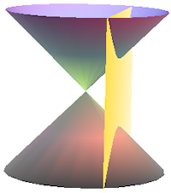
HYPERBOLA
It is the set of all the points in a plane, the difference of whose distance from the two fixed points in the plane is a constant.

Slide 24
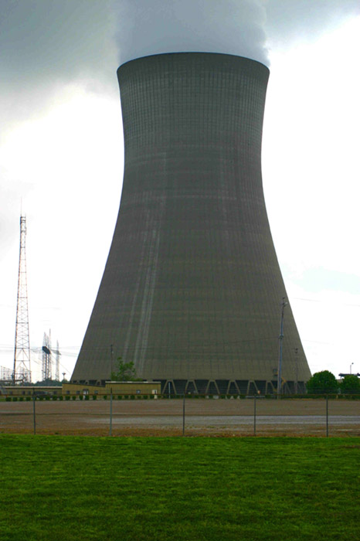
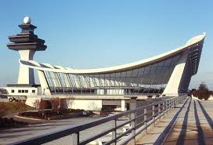
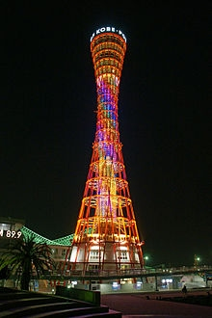
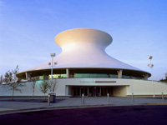
    HYPERBOLA IN SURROUNDINGS

Slide 25
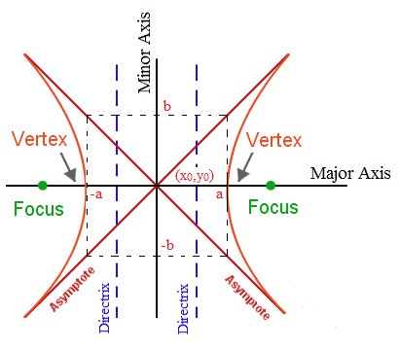
TERMS RELATED TO HYPERBOLA
The fixed points in the plane are the two focus points of an ellipse, jointly called the foci.
The line segment passing through the foci of an ellipse and touching it is called the major axis of the ellipse.

Slide 26
The two points where the major axis touches the ellipse are called the vertices of the ellipse.
The mid-point of the major axis, or the midpoint of the line segment joining the foci of an ellipse, is called the centre of the ellipse.
The line segment passing through the centre of an ellipse and perpendicular to the major axis is called the minor axis of the ellipse.
Semi-major axis = ½ major axis = a
Semi-minor axis = ½ minor axis = b
Eccentricity of an ellipse is the ratio of the distances from the centre of the ellipse to onr=e of the foci and to one of the vertices of the ellipse.
E=c/a, b^2=a^2(e^2-1), e>1

Slide 27
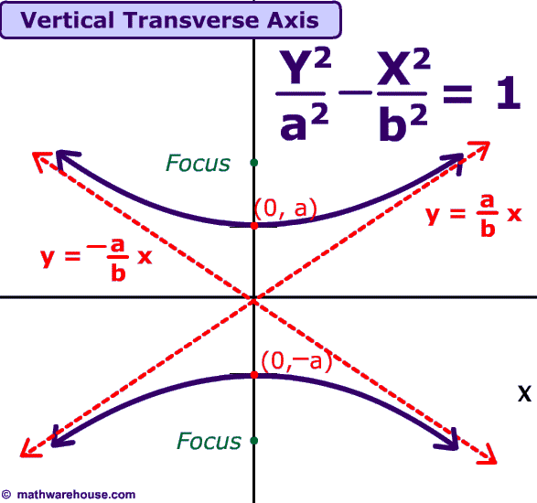
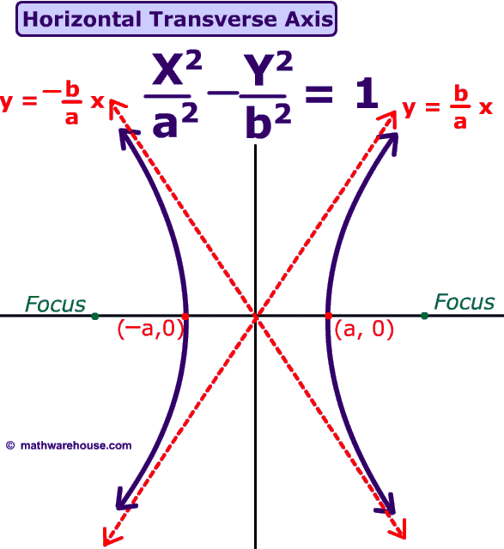
EQUATION OF HYPERBOLA
EQ…
Focus- (0,±ae)
Vertices-(0,±a)
Directrix- x = ±(a/e)
Latus rectum= 2b^2/a
Distances between the foci= 2ae
Distance between directrices- 2a/e
Focus- (±ae,0)
Vertices-(±a,0)
Directrix- x = ±(a/e)
Latus rectum= 2b^2/a
Distances between the foci= 2ae
Distance between directrices- 2a/e

Slide 28
Examples-
Q. Find the lengths of the transverse axis and conjugate axis; coordinates of the vertices and the foci, the eccentricity and the length of the latus rectum of the hyperbola x^2/16-y^2/9=1
A. Comparing with x^2/a^2-y^2/b^2=1 we get, A^2=16, a=4 and b^2=9, b=3
Therefore a=4,b=3 and e=5/4 {b^2=a^2(e^2-1)}
Length of the transverse=2a=8
Length of the conjugate=2b=6
Vertices= (-a,o), (-4,0) and (a,0), (4,0)
Foci=(± ae,0), (± 5,0)
Latus rectum=2b^2/a=9/2
Q.Find the equation of the hyperbola whose vertices are(0, ±3)and the foci are (0, ± 5).
A.Let the eq. be, y^2/a^2-x^2/b^2=1
Vertices is (0.±a) so, a=3
Foci is(0, ±ae) so e=5/3
By using {b^2=a^2(e^2-1)}, b=8 so, the eq. is y^2/36-x^2/64=1

Slide 29
Q. Find the lengths of the transverse axis and conjugate axis; coordinates of the vertices and the foci, the eccentricity and the length of the latus rectum of the hyperbola, y^2/4-x^2/9=1
A. . Comparing with y^2/a^2-x^2/b^2=1 we get, A^2=4 a=2 and b^2=9, b=3
Therefore a=2,b=3 and e=√13/2 {b^2=a^2(e^2-1)}
Length of the transverse=2a=4
Length of the conjugate=2b=6
Vertices= (0,-a), (0-2) and (0,a), (0,2)
Foci=(0,±ae), (0,± √13)
Latus rectum=2b^2/a=9

Slide 30
APPLICATION BASED QUESTIONS ON CONIC SECTIONS-
TRY THEM!!!
Q.A water jet coming out of the small opening o of a fountain reaches its maximum height of 4m at a distance of 0.5m from the vertical. Find the height of the jet above the horizontal ox at a distance of 0.75m from the point o.
Q. The cable of a uniformly loaded suspension bridge hangs in the form of a parabola. The roadway which is horizontal and 100m long is suspended by vertical wires attached to the cable, the longest wire being 30m and the shortest being 6m. Find the length of a supporting wire at the vertex is the lowest point of the cable.
Q. An arch is in the form of a semi-ellipse. It is 8m wide and 2m high at the centre. Find the height of the arch at a point 1.5m from one end.
Q. A rod of length 12cm moves with its ends always touching the coordinate axes. Determine the equation of the path of a moving point p on the rod which is 3cm from the end in contact with the x- axis.

Slide 31
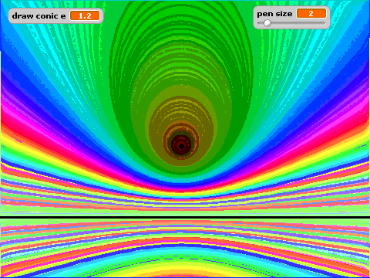
THANK YOU

